Slide 1
Michael’s Accomplishments/Goals
This sprint, my task was to clean up the HUD assets and to write a script that allows public access to each HUD object.
Committed 5 hours to this sprint.
Accomplished all 5 hours of work on the sprint goals.
I successfully cleaned up the HUD assets and I wrote/tested the script.

Slide 2
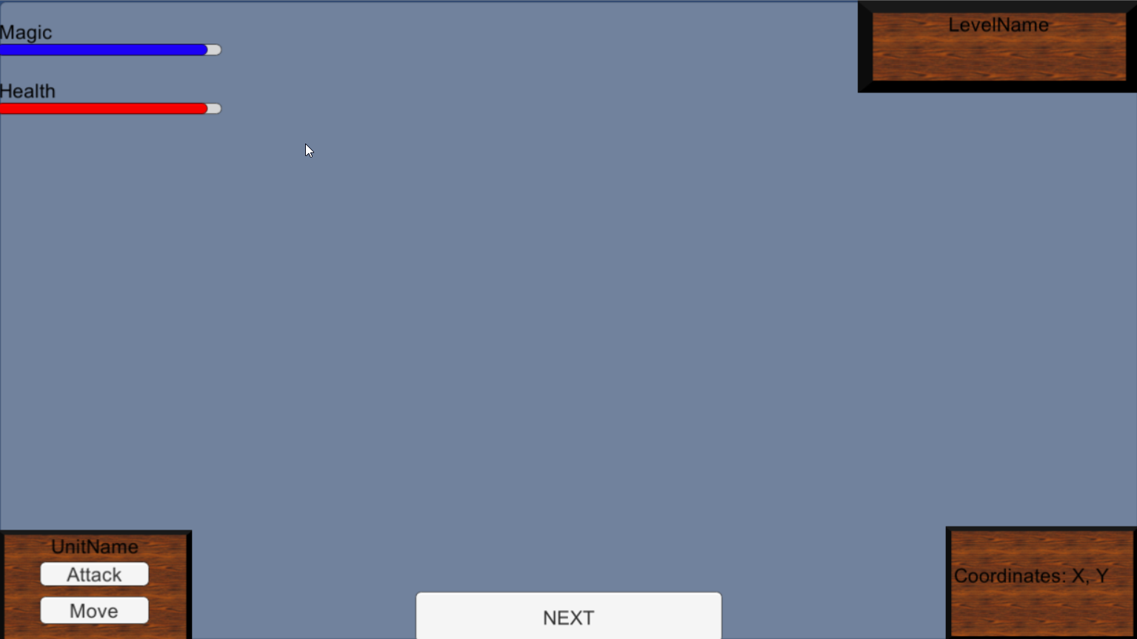

Slide 3
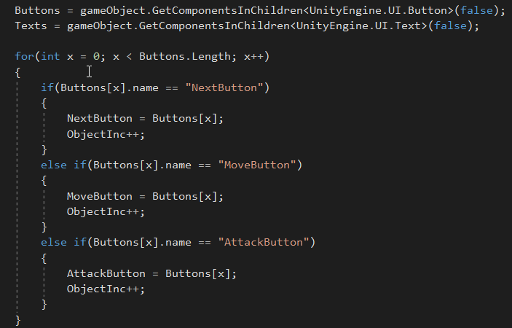
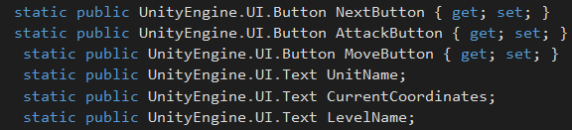
HUD Code

